Slide 1
Sockets

Slide 2
Socket
Sockets allow communication between two different processes on the same or different machines.
it's a way to talk to other computers using standard Unix file descriptors.
Sockets were first introduced in 2.1BSD and subsequently refined into their current form with 4.2BSD. The sockets feature is now available with most current UNIX system releases.

Slide 3
Bidirectional.
Socket is a end-point communication.
Socket: An interface between an application process and transport layer.
The application process can send/receive messages to/from another application process (local or remote)via a socket.

Slide 4
End point determined by two things:
Host address: IP address in Network Layer
Port number: is Transport Layer
Two end-points determine a connection:
socket pair
– ex: 206.62.226.35,p21 + 198.69.10.2,p1500
– ex: 206.62.226.35,p21 + 198.69.10.2,p1499
Create Socket
– socket(domain,type,protocol)

Slide 5
Domain: method of identifing sockets(address)
– Range of Communicatin
Process on a single host
Across a network
Type: Stream/Datagram
Protocol: Usually 0, which means default

Slide 6
Common Socket Domains
Unix Domain (AF_UNIX)
Communication on a single host
Adress->file system path name
IPv4 Domain (AF_INET)
Communication on IPv4 network
Address->IPv4 address (32bit)+Port No
IPv6 Domain (AF_INET6)
Communication on IPv6 network
Address->IPv4 address (128bit)+Port No

Slide 7
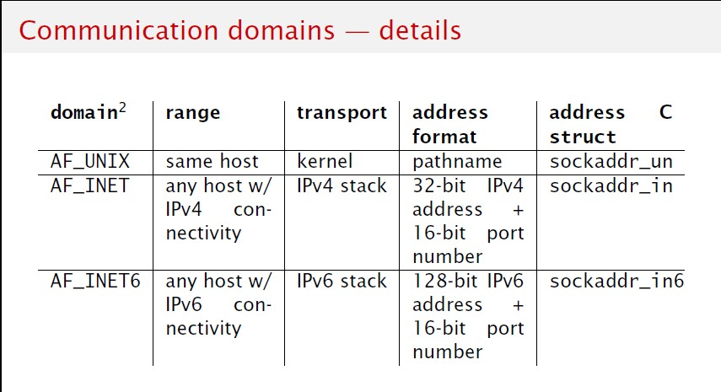

Slide 8
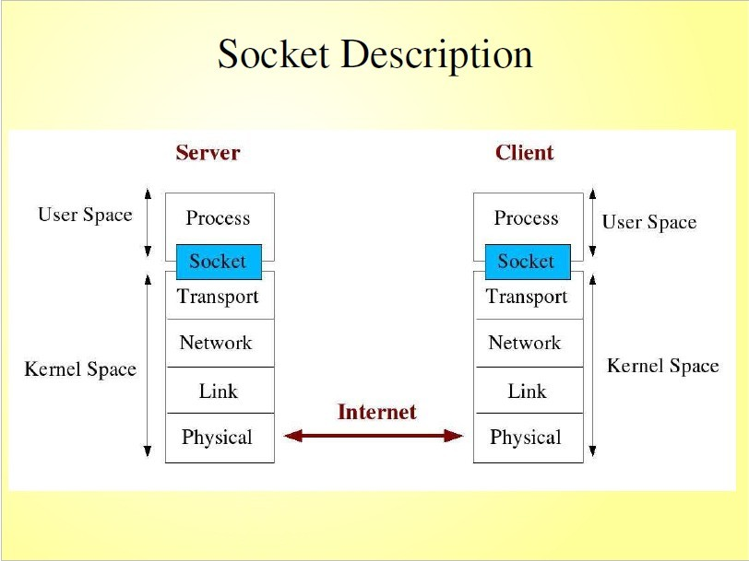

Slide 9
Ports
Numbers (typical, since vary by OS):
– 0-1023 “reserved”, must be root
– 1024 - 5000 “ephemeral”
– Above 5000 for general use
(50,000 is specified max)
Well-known, reserved services (see
/etc/services in Unix):
ftp
telnet
finger
snmp
21/tcp 23/tcp 79/tcp 161/udp

Slide 10
Using Ports to Identify Services
Server host 128.2.194.242
Service request for 128.2.194.242:80
Client host
Web server (port 80)
(i.e., the Web server)
Client
OS
Echo server (port 7)
Service request for 128.2.194.242:7
Web server (port 80)
(i.e., the echo server)
Client
OS
Echo server (port 7)
10

Slide 11
Socket Types
Two main Types are:-
UDP: User Datagram Protocol
(SOCK_STREAM)
TCP: Transmission Control Protocol
(SOCK_DGRAM)
Other domain provided by UNIX system is
Sequential Packet
(SOCK_SEQPACKET)

Slide 12
Stream Socket(TCP)
Byte streamr
reliable (in order, all arrive, no duplicates)
flow control
Two channels on the socket for send bytes to each other
Connection-oriented
* Eg: like two party phone calls

Slide 13
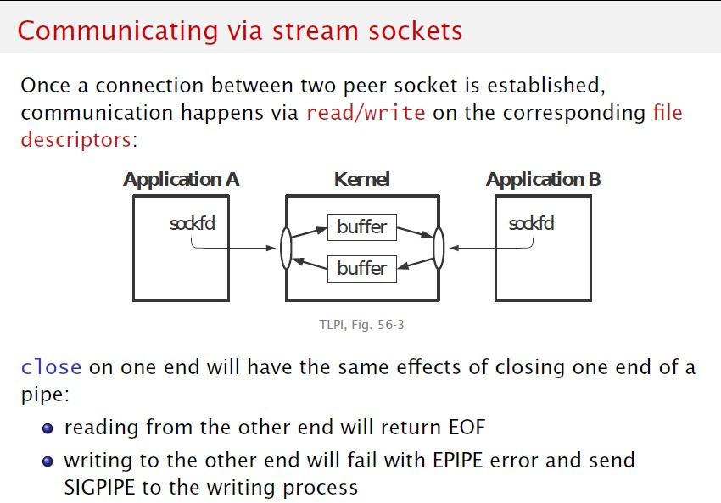

Slide 14
Datagram Socket(UDP)
Message oriented
no acknowledgements
no retransmissions
Unreliable (out of order, duplicates)
Connection less
* Eg: Postal System

Slide 15
Sequential Packet Socket(SCTP)
It is not widely used protocol
Midway between stream and datagram socket
Message oriented
Connection oriented
Reliable

Slide 16
Addresses and Sockets
Structure to hold address information
Functions pass address from user to OS
bind() connect() sendto()
Functions pass address from OS to user
accept() recvfrom()

Slide 17
Socket Address Structure
struct in_addr { in_addr_t s_addr;
};
struct sockaddr_in {
/* 32-bit IPv4 addresses */
unit8_t sin_len; /* length of structure */ sa_family_t sin_family; /* AF_INET *domain/ in_port_t sin_port; /* TCP/UDP Port num */ struct in_addr sin_addr; /* IPv4 address (above) */ char sin_zero[8]; /* unused */
}
Are also “generic” and “IPv6” socket structures

Slide 18
TCP Client-Server
Passive Socket
Server
socket()
bind()
“well-known”
port
ActiveSocket
listen()
Client
accept()
socket()
connect()
(Block until connection)
“Handshake”
Data (request)
send()
recv()
close()
recv()
Data (reply)
send()
End-of-File
recv()

Slide 19
socket()
int socket(int family, int type, int protocol);
Create a socket, giving access to transport layer service.
family is one of
AF_INET (IPv4), AF_INET6 (IPv6), AF_LOCAL (local Unix),
AF_ROUTE (access to routing tables), AF_KEY (new, for encryption)
type is one of
SOCK_STREAM (TCP), SOCK_DGRAM (UDP)
SOCK_RAW (for special IP packets, PING, etc. Must be root)
 setuid bit (-rws--x--x root 1997 /sbin/ping*)
protocol is 0 (used for some raw socket options)
upon success returns socket descriptor
Integer, like file descriptor
Return -1 if failure

Slide 20
bind()
int bind(int sockfd, const struct sockaddr *myaddr, socklen_t addrlen);
Assign a local protocol address (“name”) to a socket.
sockfd is socket descriptor from socket()
myaddr is a pointer to address struct with:
port number and IP address
if port is 0, then host will pick ephemeral port
not usually for server (exception RPC port-map)
IP address != INADDR_ANY (unless multiple nics)
addrlen is length of structure
returns 0 if ok, -1 on error
EADDRINUSE (“Address already in use”)

Slide 21
listen()
int listen(int sockfd, int backlog);
Change socket state for TCP server.
sockfd is socket descriptor from socket()
backlog is maximum number of incomplete
connections
historically 5
rarely above 15 on a even moderate Web server!
Sockets default to active (for a client)
– change to passive so OS will accept connection

Slide 22
accept()
int accept(int sockfd, struct sockaddr
cliaddr, socklen_t *addrlen);
Return next completed connection.
sockfd is socket descriptor from socket()
cliaddr and addrlen return protocol address from client
returns brand new descriptor, created by OS
note, if create new process or thread, can create concurrent server

Slide 23
close()
int close(int sockfd);
Close socket for use.
sockfd is socket descriptor from socket()
closes socket for reading/writing
returns (doesn’t block)
attempts to send any unsent data
socket option SO_LINGER
block until data sent
or discard any remaining data
returns -1 if error

Slide 24
Server
TCP Client-Server
socket()
“well-known”
bind()
port
listen()
Client
socket()
accept()
(Block until connection)
“Handshake”
connect()
Data (request)
send()
recv()
Data (reply)
send()
recv()
End-of-File
close()
recv()

Slide 25
connect()
int connect(int sockfd, const struct sockaddr
*servaddr, socklen_t addrlen);
sockfd is so_{C}ck_{o}e_{n}t_{ne}d_{c}e_{t} s_{to}cr_{s}i_{e}p_{r}t_{v}o_{e}r_{r.}from socket()
servaddr is a pointer to a structure with:
port number and IP address
must be specified (unlike bind())
addrlen is length of structure
client doesn’t need bind()
OS will pick ephemeral port
returns socket descriptor if ok, -1 on error

Slide 26
Sending and Receiving
int recv(int sockfd, void *buff, size_t
mbytes, int flags);
int send(int sockfd, void *buff, size_t
mbytes, int flags);
Same as read() and write() but for flags
MSG_DONTWAIT (this send non-blocking)
MSG_OOB (out of band data, 1 byte sent ahead)
MSG_PEEK (look, but don’t remove)
MSG_WAITALL (don’t give me less than max)
MSG_DONTROUTE (bypass routing table)

Slide 27
UDP Client-Server
Server
socket()
bind()
“well-known”
Client
recvfrom()
port
socket()
(Block until receive datagram)
Data (request)
sendto()
recvfrom()
 | close()
sendto()
Data (reply)
No “handshake”
No simultaneous close
No fork()/spawn() for concurrent servers!

Slide 28
Sending and Receiving
int recvfrom(int sockfd, void *buff, size_t mbytes, int flags, struct sockaddr *from, socklen_t
*addrlen);
int sendto(int sockfd, void *buff, size_t mbytes, int flags, const struct sockaddr *to, socklen_t addrlen);
Same as recv() and send() but for addr
recvfrom fills in address of where packet came from
sendto requires address of where sending packet to

Slide 29
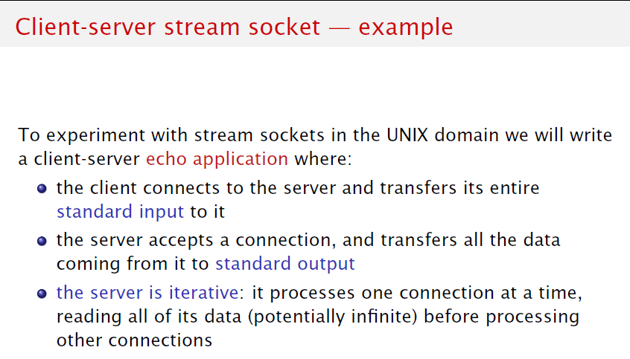

Slide 30
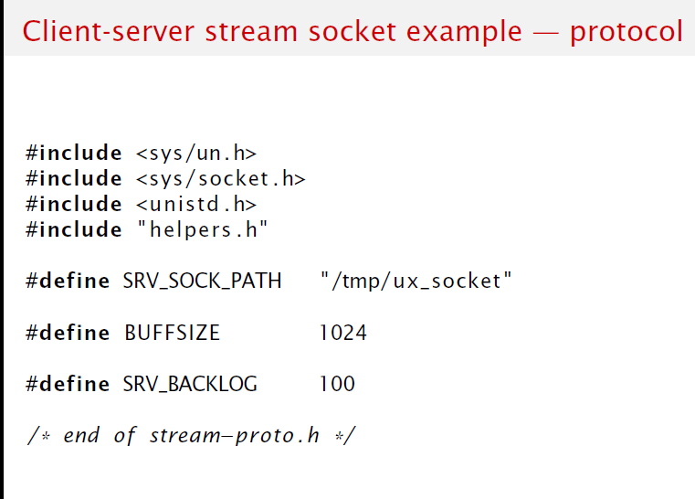

Slide 31
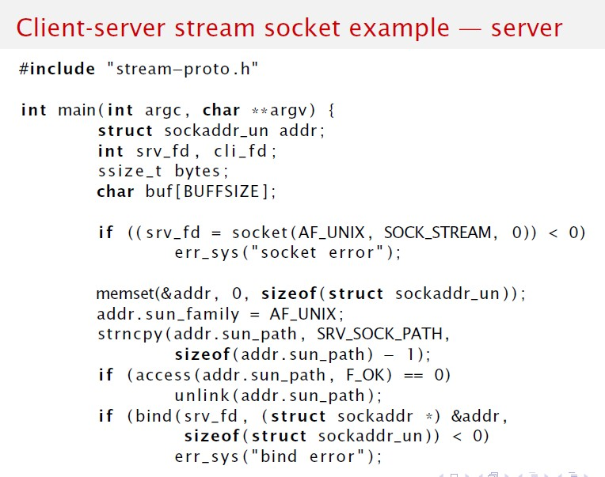

Slide 32
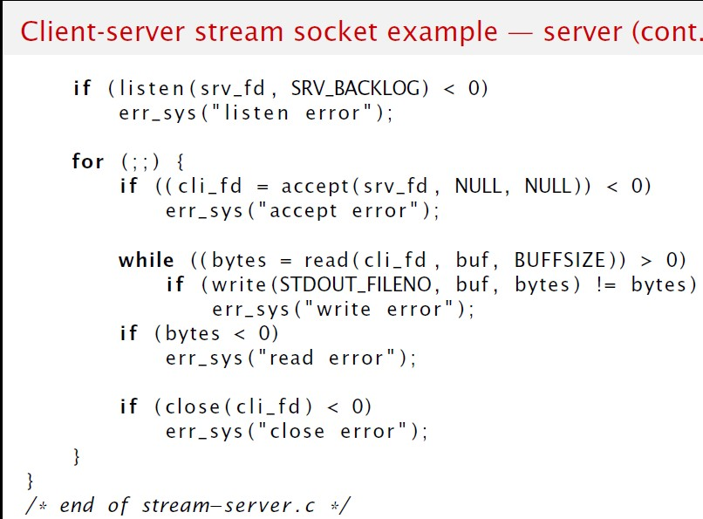

Slide 33
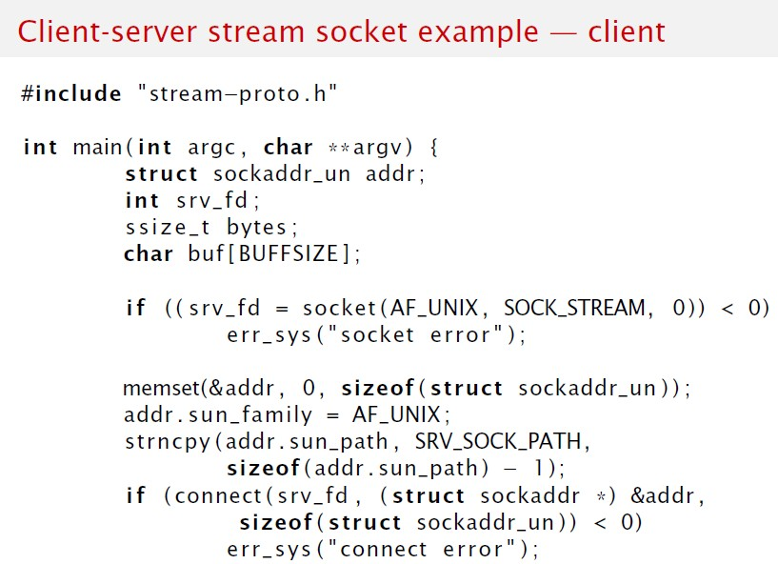

Slide 34
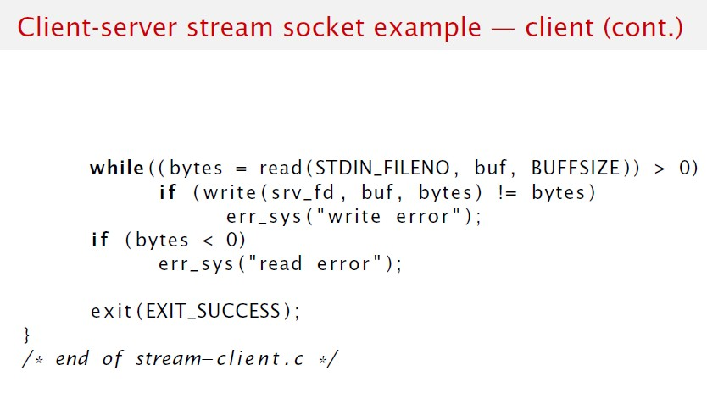

Slide 35
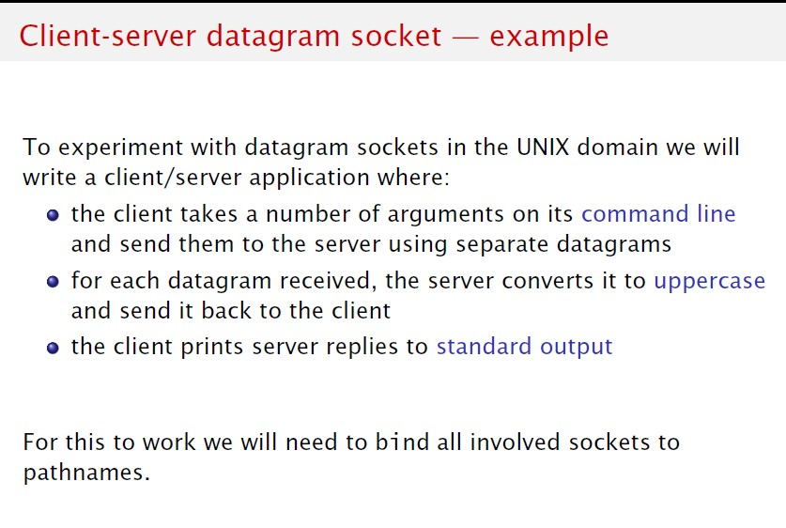

Slide 36
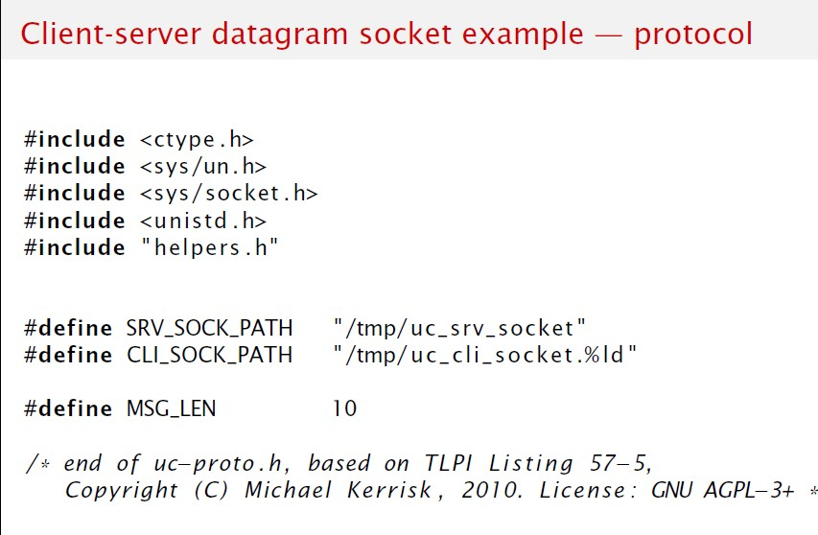

Slide 37
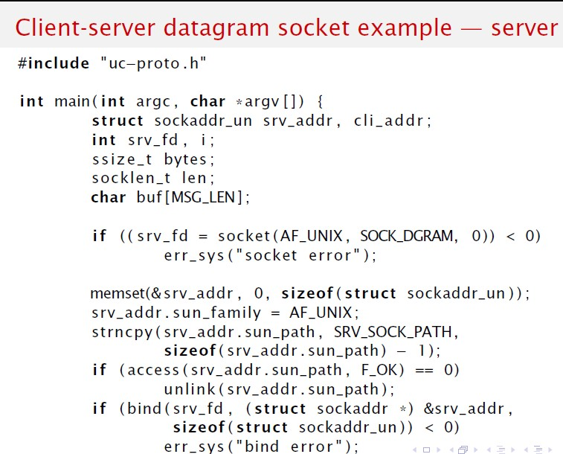

Slide 38
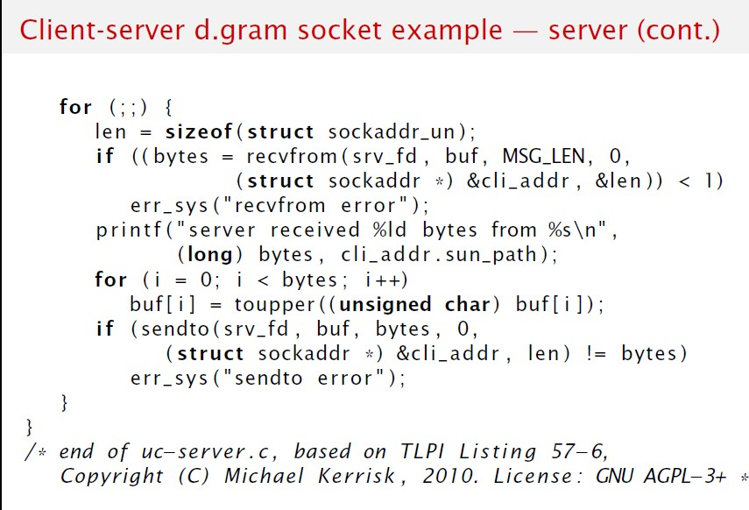

Slide 39
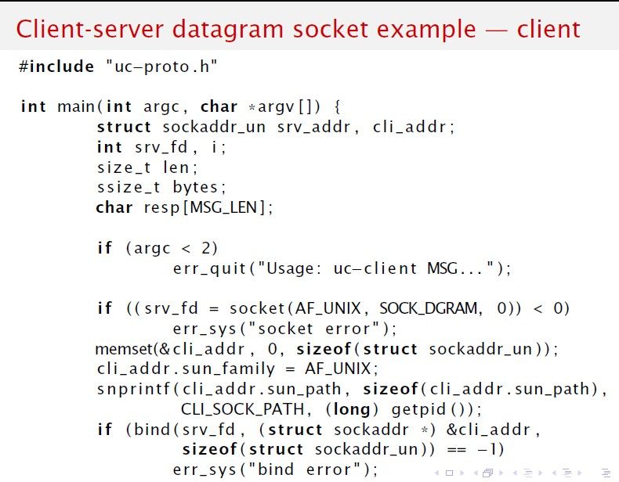

Slide 40
